Slide 1

Predicting Cardiovascular Risk with Machine Learning: A Classification Project

Slide 2
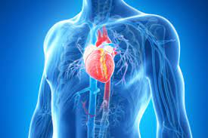
Understanding Cardiovascular Risk Prediction
Cardiovascular diseases (CVDs) remain a leading cause of mortality worldwide, posing significant public health challenges.
Predicting cardiovascular risk plays a pivotal role in preventive healthcare, enabling early intervention and risk management.
In this presentation, we delve into the importance of cardiovascular risk prediction models and their implications for personalized healthcare.
By leveraging data-driven approaches and predictive analytics, we aim to empower healthcare professionals and individuals in making informed decisions to mitigate cardiovascular risks effectively.

Slide 3
Landscape of Cardiovascular Risk Factors
Definition of Cardiovascular Risk Factors:
Introduction to key factors contributing to cardiovascular diseases, including hypertension, diabetes, obesity, smoking, and family history.
Understanding Risk Factor Interactions:
Explore how multiple risk factors synergistically contribute to increased cardiovascular risk.
Importance of Risk Factor Assessment:
Highlight the necessity of assessing and monitoring individual risk factors to estimate overall cardiovascular risk accurately.
Role of Lifestyle and Behavioral Factors:
Discuss the impact of lifestyle modifications, such as diet, exercise, and stress management, in reducing cardiovascular risk.

Slide 4
Risk Factors (attributes info)
• Diabetes: whether or not the patient had diabetes (Nominal) Medical(current)
• Tot Chol: total cholesterol level
• Sys BP: systolic blood pressure
• Dia BP: diastolic blood pressure
• BMI: Body Mass Index
• Heart Rate: heart rate
• Glucose: glucose level
• CHD: 10-year risk of coronary heart disease CHD(binary: “1”, means “Yes”, “0” means “No”)
Demographic:
• Sex: male or female("M" or "F")
• Age: Age of the patient
Behavioral:
• is-smoking: whether or not the patient is a current smoker ("YES" or "NO")
• Cigs Per Day: the number of cigarettes that the person smoked on average in one day
Medical(History):
• BP Meds: whether or not the patient was on blood pressure medication
• Prevalent Stroke: whether or not the patient had previously had a stroke
• Prevalent Hyp: whether or not the patient was hypertensive

Slide 5
Data Overview and Preprocessing
Dataset consists of 2917 records and 16 features.
No duplicate values were found in the dataset.
All continuous variables, except age, are positively skewed.
Majority of patients have education level 1, followed by 2, 3, and 4
Female patients outnumber male patients.
'Systolic BP' and 'Diastolic BP' are highly correlated.

Slide 6
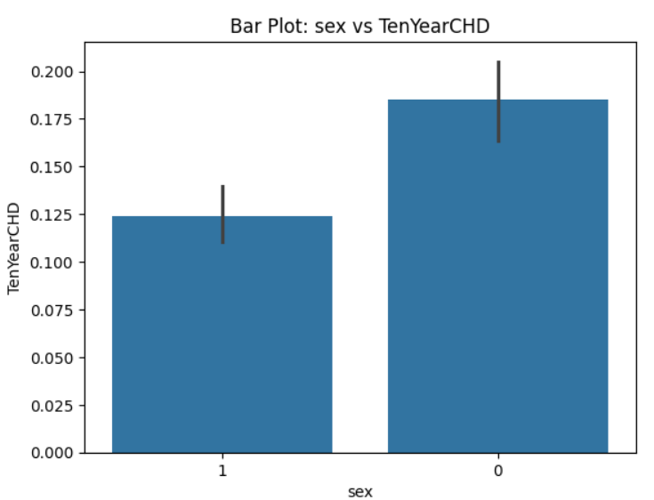
GENDER AS A RISK FACTOR
The dataset comprises a higher proportion of female patients, underscoring the significance of gender in analyzing cardiovascular disease (CVD) prediction, as gender-specific physiological differences and risk factors influence disease manifestation, diagnosis, and treatment strategies.

Slide 7
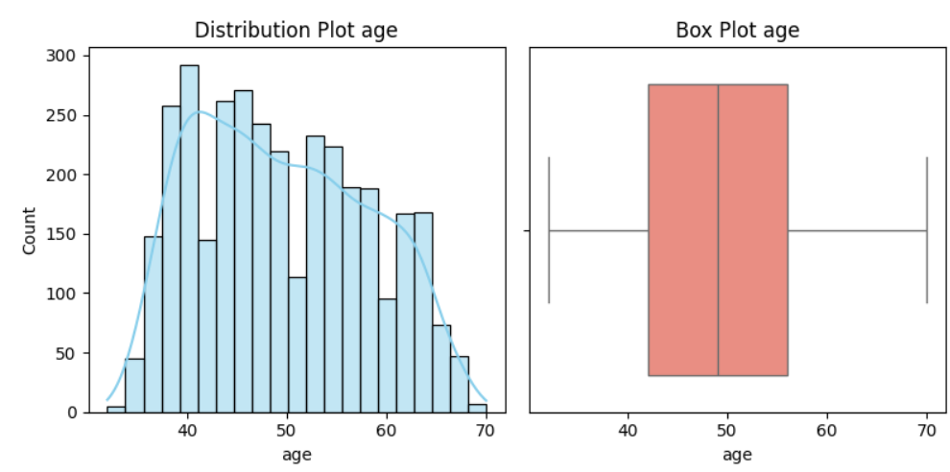
Age as a risk factor
A dynamic age group range spanning from 32 to 70 years is important for cardiovascular disease analysis as it captures a wide spectrum of age-related risk factors and enables comprehensive evaluation of disease onset, progression, and management across various life stages.

Slide 8
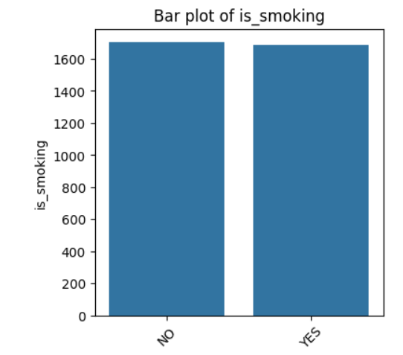
Smoking as a risk factor
Checking smoking status is crucial for cardiovascular health assessment due to its strong association with increased risk of heart disease and other cardiovascular complications.
There are more non-smoker patients in the dataset.

Slide 9
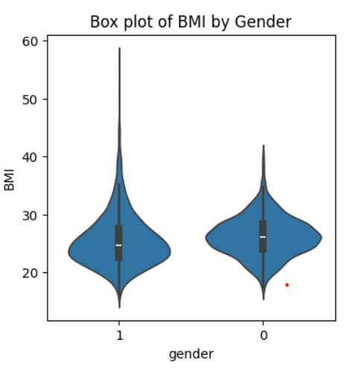
BMI as a risk factor
Male has BMI between 20-40.
Female has BMI between 20-60 this shows that there are more female patient who suffer from obesity, this can be because there is more female patient record in the dataset so there is more variation in female patient data.

Slide 10
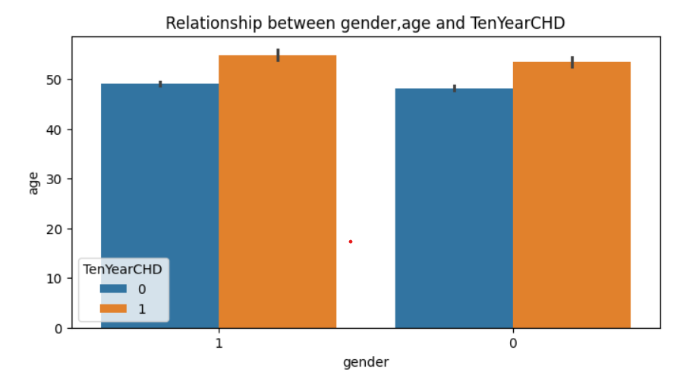
Relation between various factors
Given the prevalence of female patients in our dataset, the bar plot underscores that older females, in particular, exhibit a higher incidence of cardiovascular risk.
In our dataset, there's a notable trend indicating that older patients are at a higher risk of cardiovascular disease

Slide 11
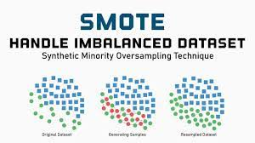
Data Preprocessing Techniques
Scaling the data using MinMaxScaler for normalization.
Data transformation through log transformation to handle skewness.
Balancing the class using SMOTE to address class imbalance.

Slide 12
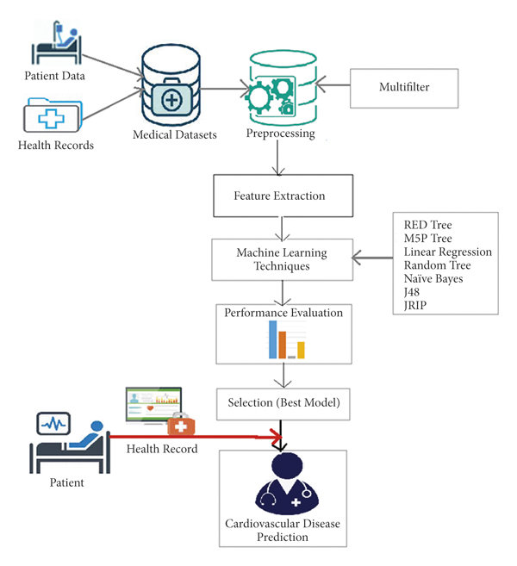
Model Implementation and Evaluation
Implemented models include Linear Regression, Lasso Regression, Ridge Regression, Logistic Regression, Elastic Net Regression, Decision Tree Classifier, Random Forest Classifier, Gradient Boosting Classifier, KNN Classifier, and SVC.
Random Forest Classifier and Gradient Boosting Classifier exhibit higher accuracy and precision scores on both training and testing datasets.

Slide 13


Evaluation Metrics Overview
Recall: Random Forest Classifier shows high recall, ensuring detection of individuals with cardiovascular problems.
Precision: Ridge Regression, ElasticNet Regression, and Random Forest Classifier demonstrate high precision in identifying individuals with cardiovascular disease.
F1 Score: Random Forest Classifier achieves a high F1 score, balancing between catching individuals with cardiovascular problems and ensuring accuracy.

Slide 14
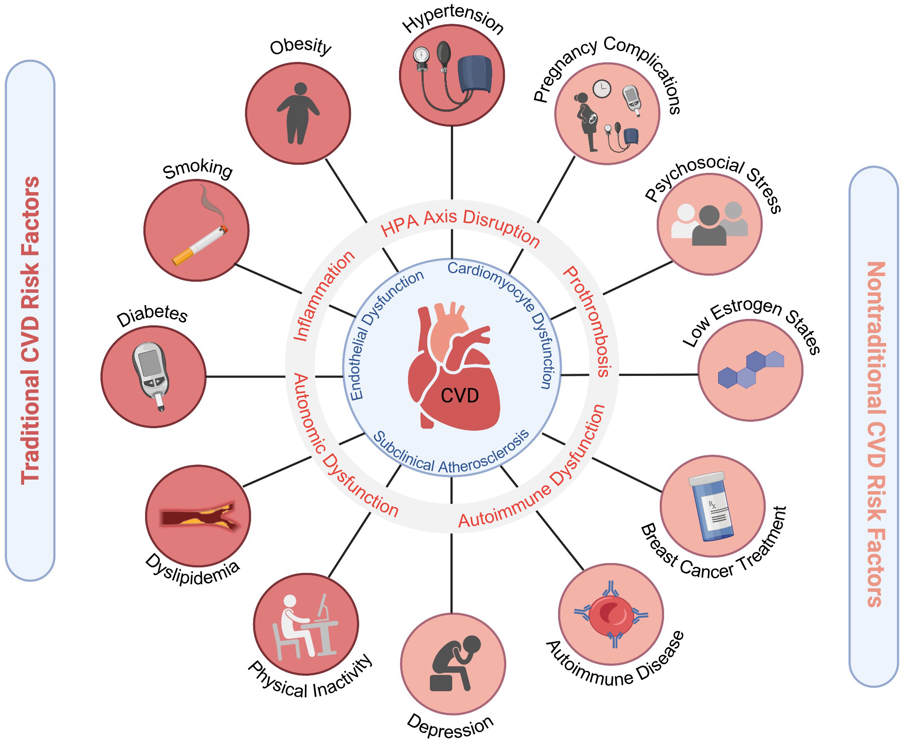

Conclusion and Recommendations
The analysis highlights the effectiveness of predictive models, especially Random Forest Classifier, in cardiovascular disease prediction.
Recommendations include further refinement of models and exploration of additional predictive features for enhanced accuracy.

Slide 15

Thank you
Mirjam Nilsson
SERVICE REPRESENTATIVE

